Slide 1
Moderation and Mediation
Prof. Andy Field

Slide 2
Moderation
The combined effect of two variables on another is known conceptually as moderation, and in statistical terms as an interaction effect.

Slide 3
Example
Do violent video games make people antisocial?
Participants
442 youths
Outcome
Aggression,
Callous unemotional traits (CaUnTs)
Number of hours spent playing video games per week

Slide 4
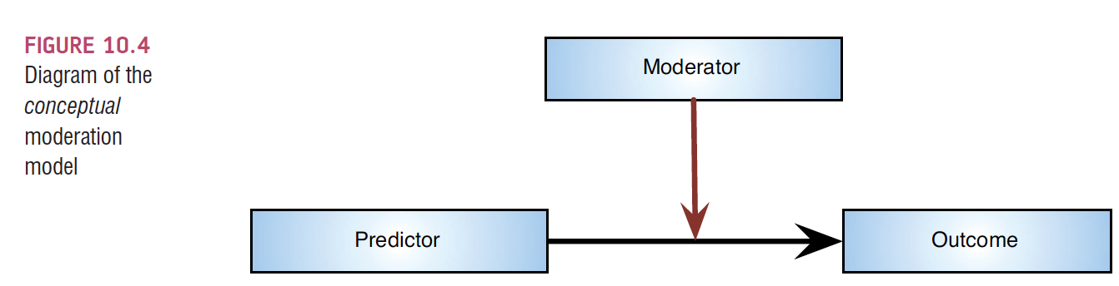
Conceptual moderation model
If callous-unemotional traits were a moderator then we’re saying that the strength or direction of the relationship between game playing and aggression is affected by callous-unemotional traits.

Slide 5
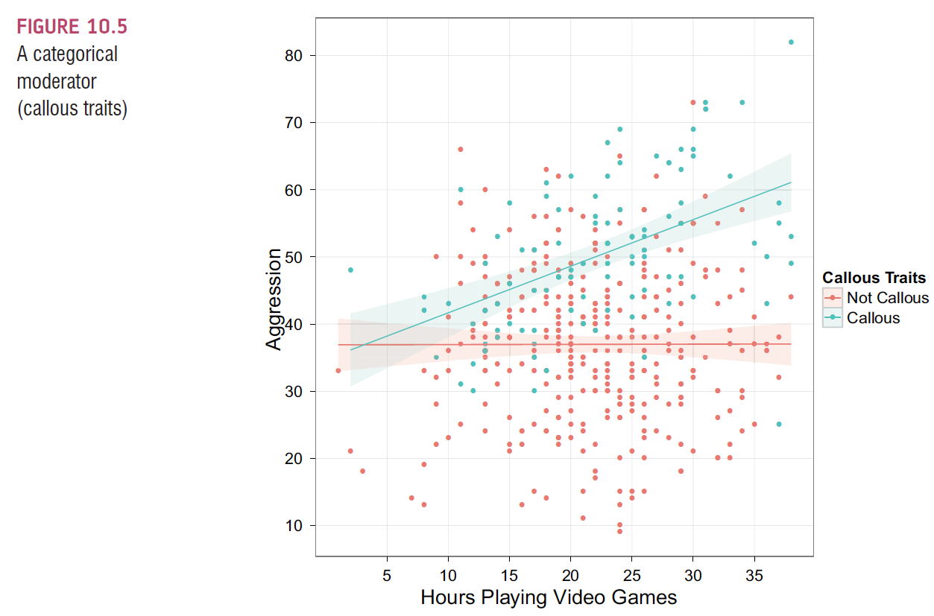

Slide 6
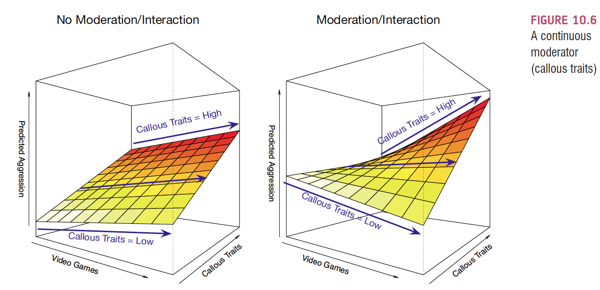

Slide 7
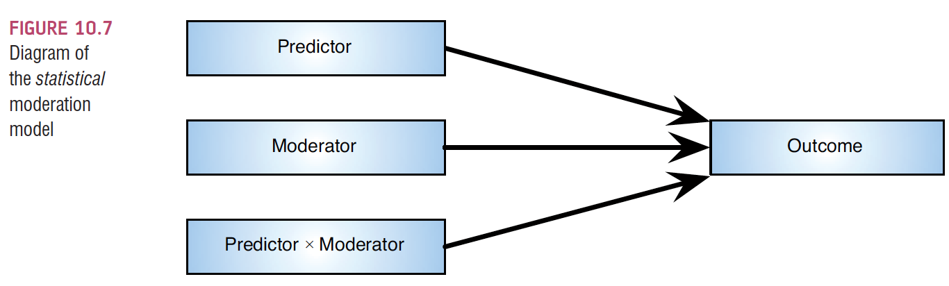
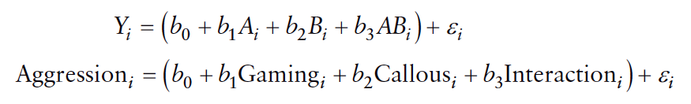
The Statistical Moderation Model

Slide 8
Centering variables
The interaction term makes the bs for the main predictors uninterpretable in many situations.
For this reason, it is common to transform the predictors using grand mean centring.
Centring refers to the process of transforming a variable into deviations around a fixed point.

Slide 9
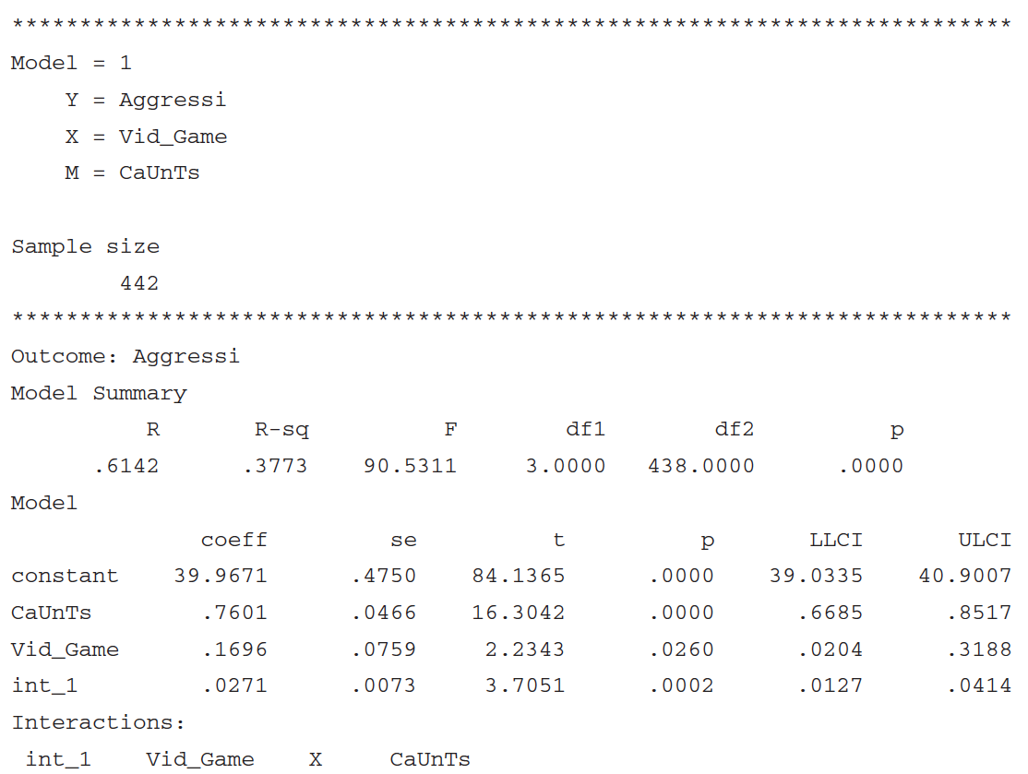
Output from moderation analysis

Slide 10
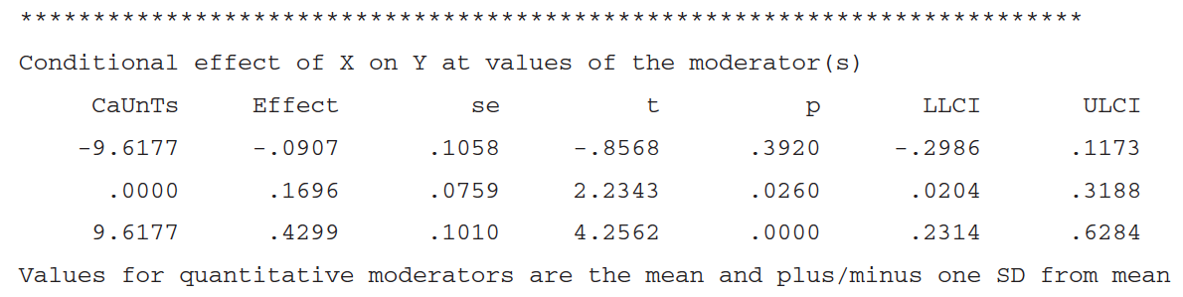
Output from moderation analysis II

Slide 11
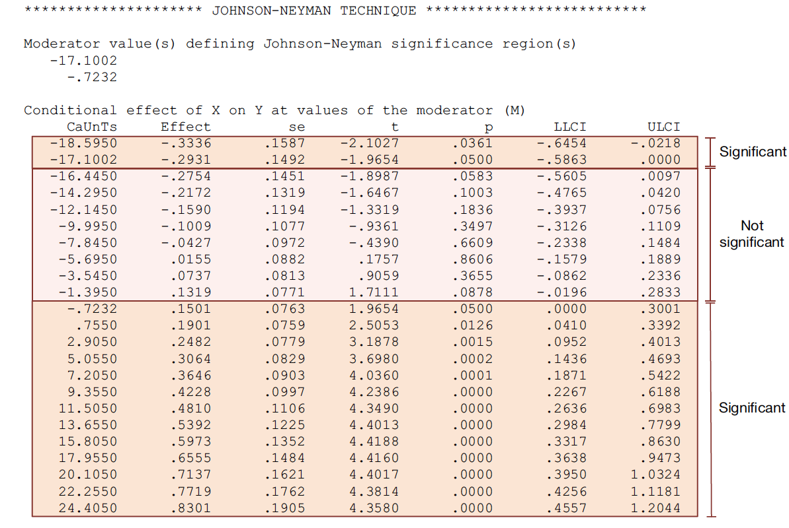
Output from moderation analysis III

Slide 12
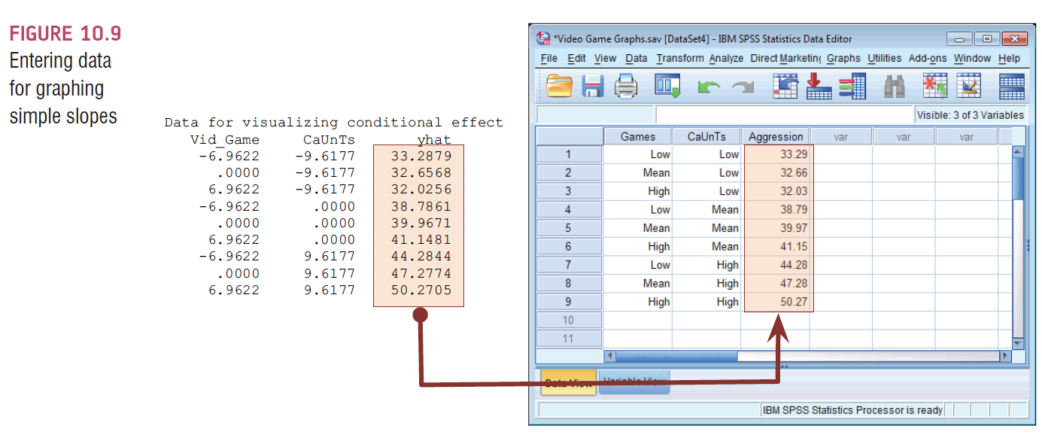
Following up Moderation with Simple Slopes analysis

Slide 13
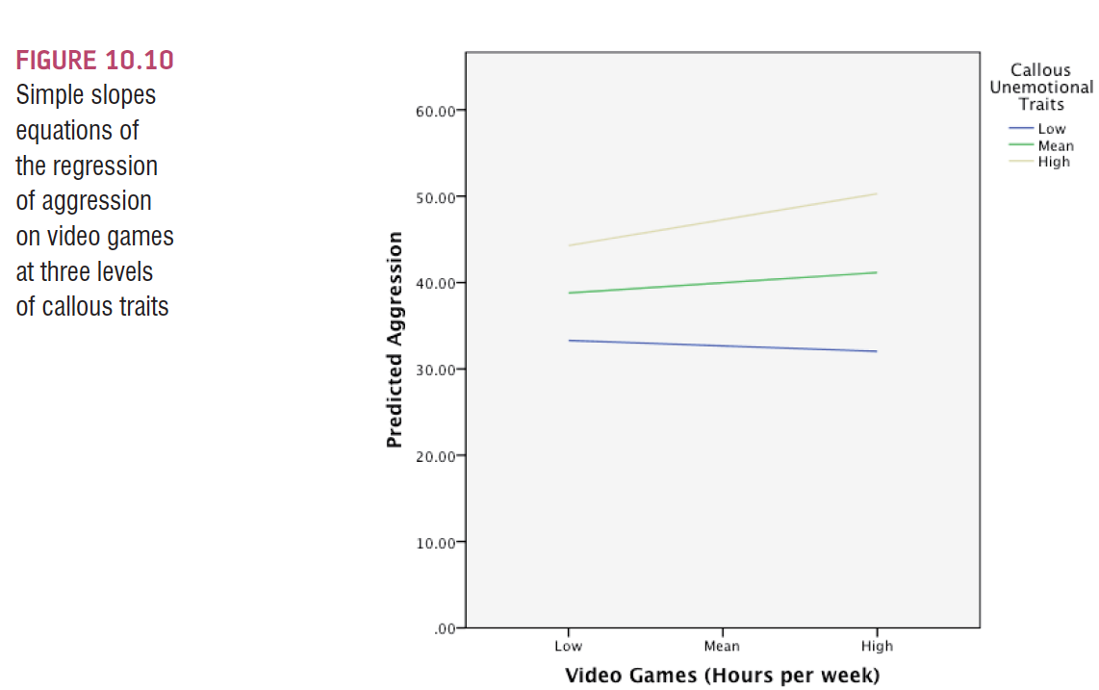

Slide 14
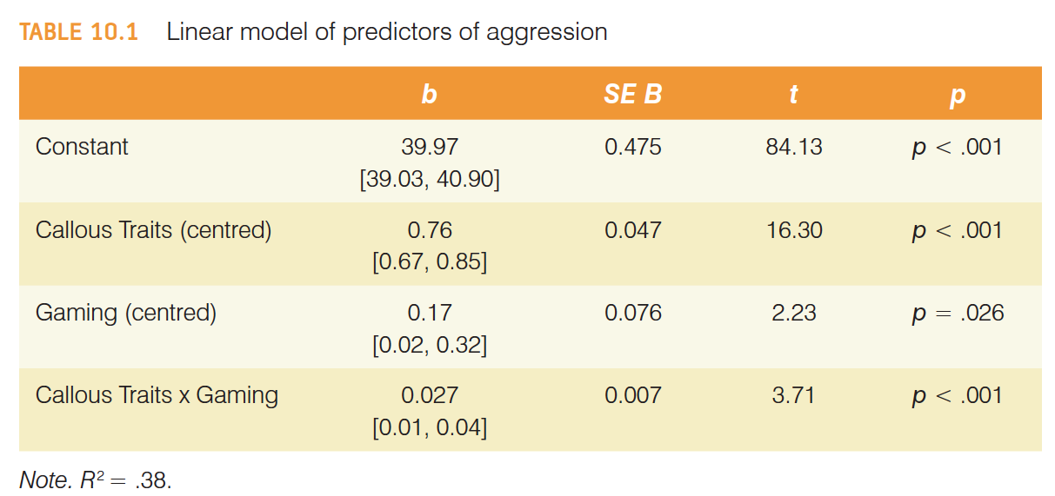
Reporting moderation analysis

Slide 15
Mediation
Refers to a situation when the relationship between a predictor variable and outcome variable can be explained by their relationship to a third variable (the mediator).

Slide 16
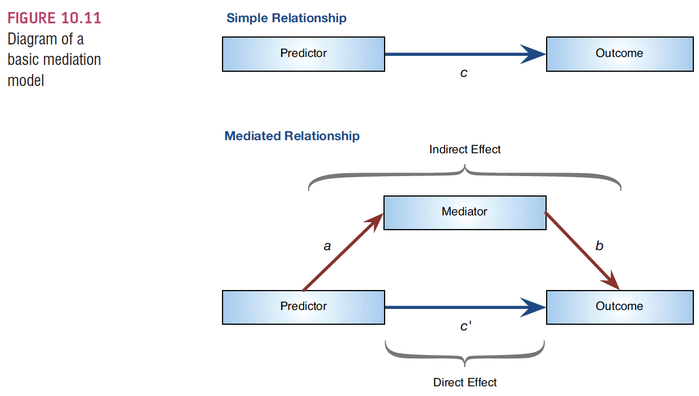
The Statistical Model

Slide 17
Baron & Kenny, (1986)
Mediation is tested through three regression models:
Predicting the outcome from the predictor variable.
Predicting the mediator from the predictor variable.
Predicting the outcome from both the predictor variable and the mediator.

Slide 18
Baron & Kenny, (1986)
Four conditions of mediation:
The predictor must significantly predict the outcome variable.
The predictor must significantly predict the mediator.
The mediator must significantly predict the outcome variable.
The predictor variable must predict the outcome variable less strongly in model 3 than in model 1.

Slide 19
Limitations of Baron & Kenny’s (1986) Approach
How much of a reduction in the relationship between the predictor and outcome is necessary to infer mediation?
people tend to look for a change in significance, which can lead to the ‘all or nothing’ thinking that p-values encourage.

Slide 20
Sobel Test (Sobel, 1982)
An alternative is to estimate the indirect effect and its significance using the Sobel test (Sobel. 1982).
If the Sobel test is significant, there is significant mediation

Slide 21
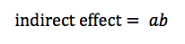
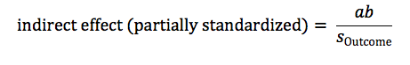
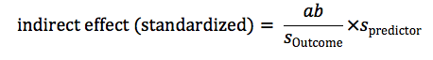
Effect Sizes of Mediation

Slide 22
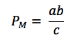
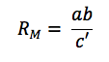
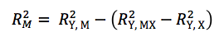
Effect Sizes of Mediation II

Slide 23
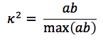
Effect Sizes of Mediation III Kappa-squared (k²) (Preacher & Kelley, 2011)

Slide 24
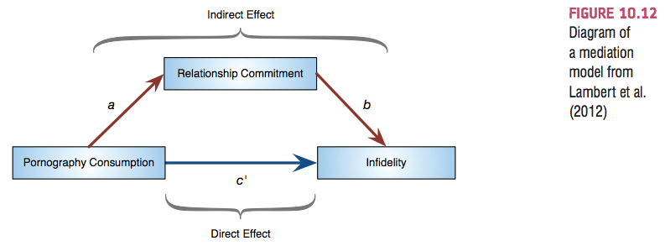
Example of a Mediation Model

Slide 25
Running the Analysis

Slide 26
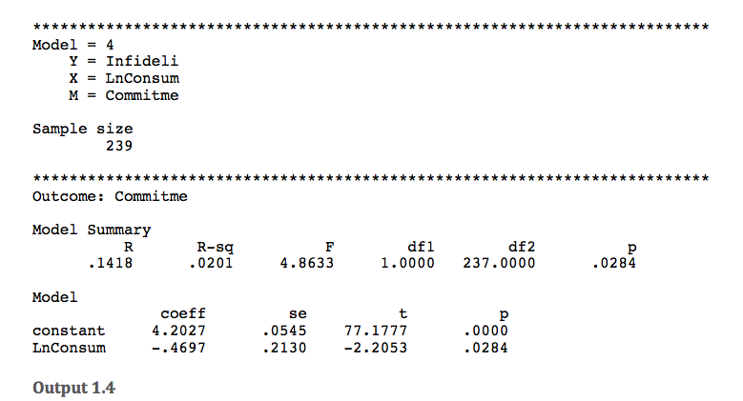
Output from Mediation Analysis

Slide 27
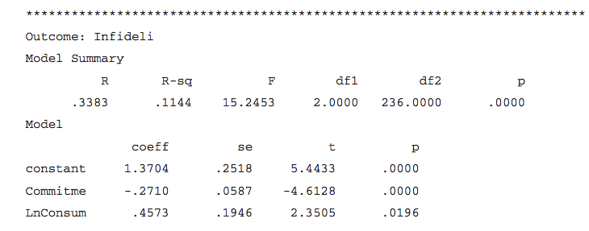
Output from Mediation Analysis II

Slide 28
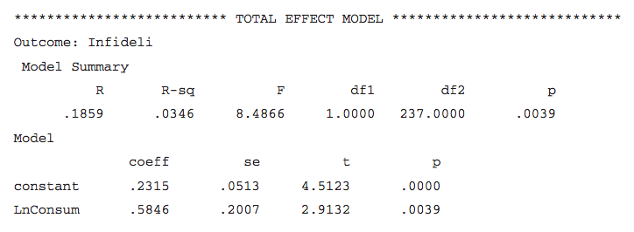
Output from Mediation Analysis III

Slide 29
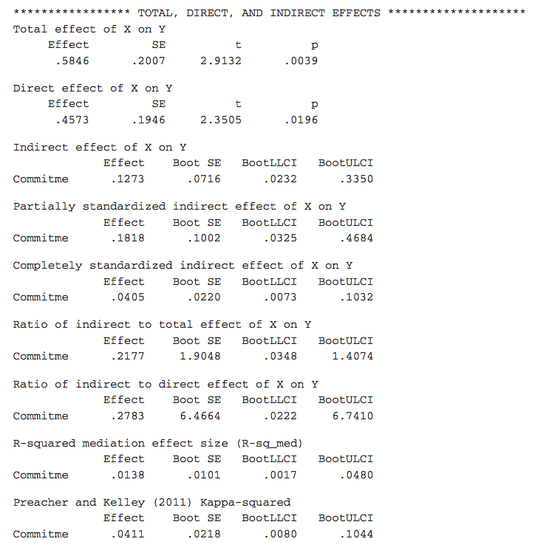
Output from Mediation Analysis IIII

Slide 30
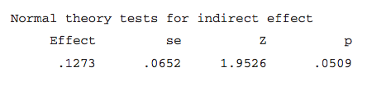
Output from Mediation Analysis – Results of Sobel test

Slide 31
Reporting Mediation Analysis
There was a significant indirect effect of pornography consumption on infidelity though relationship commitment, b = 0.127, BCa CI [0.023, 0.335]. This represents a relatively small effect, κ² = .041, 95% BCa CI [.008, .104].

Slide 32
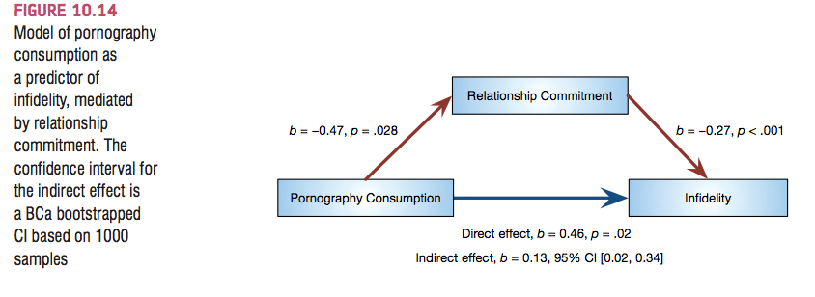
Reporting Mediation Analysis

Slide 33
Categorical Predictors in Regression
Often you will have categorical predictors that have more than two categories.
These groups cannot be distinguished using a single variable coded with zeros and ones. Therefore, we use what’s called dummy variables.

Slide 34
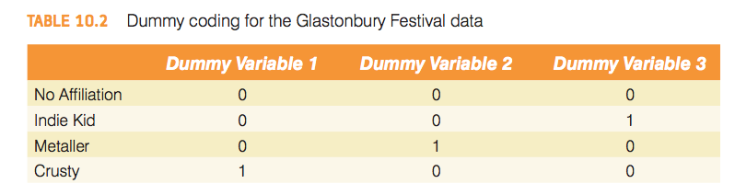
Dummy coding for the Glastonbury Festival data

Slide 35
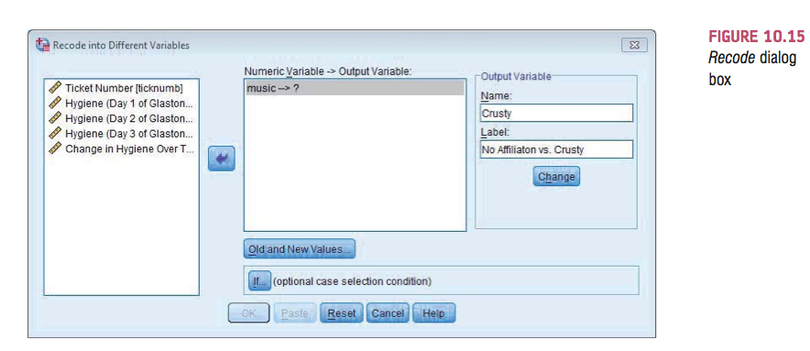

Slide 36
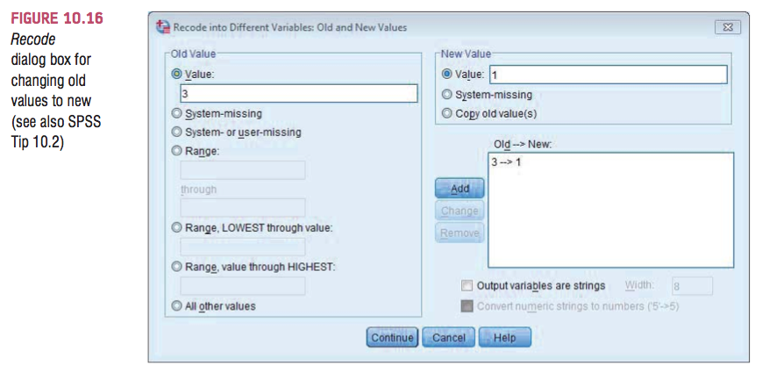

Slide 37
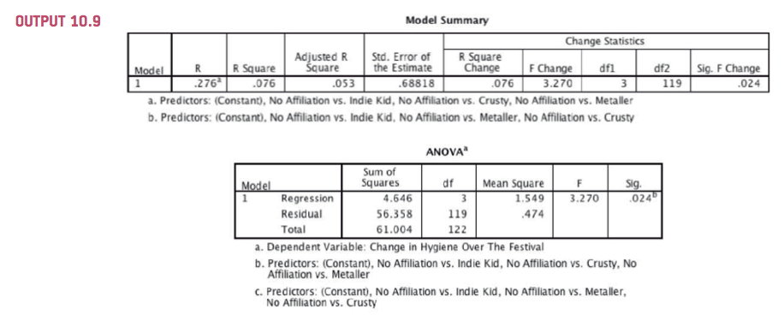
SPSS Output for Dummy Variables

Slide 38
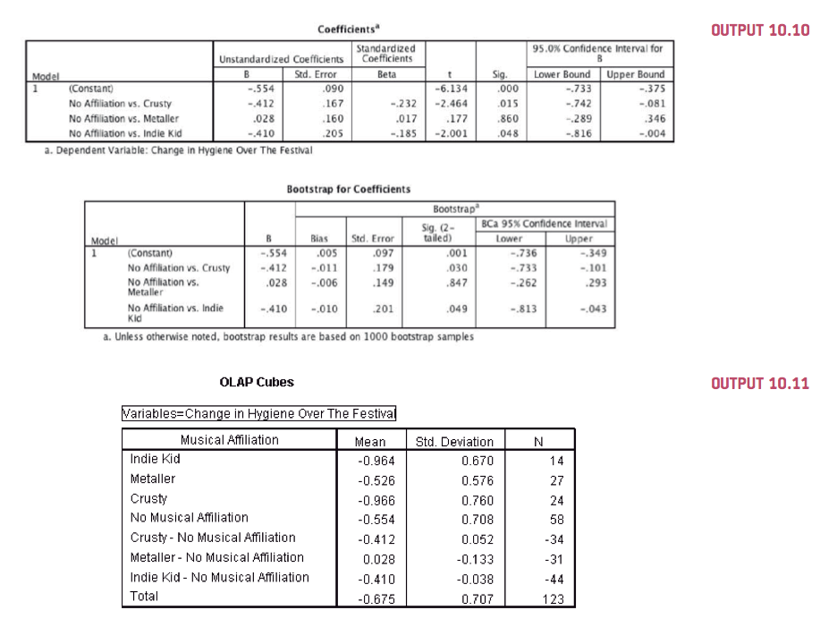
SPSS Output for Dummy Variables II

Slide 39
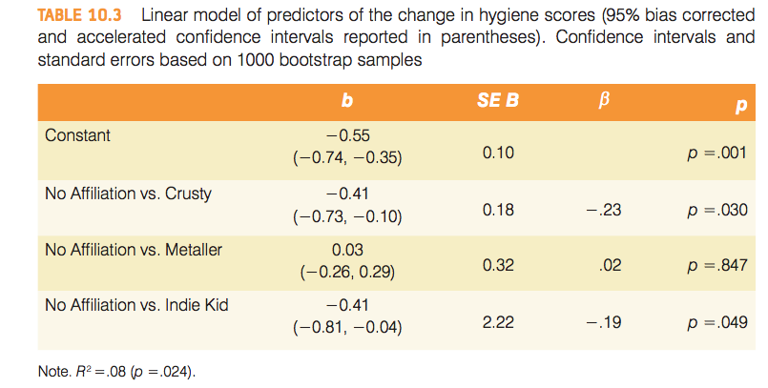
Reporting Results

